Slide 1


Integrative data science in mass spectrometry: connecting molecular structures with diverse MS behaviors
Stepan Stepanovic and Gérard Hopfgartner
stepanstepanovic.github.io
Life Science Mass Spectrometry, Geneva
Life Sciences Mass Spectrometry, Department of Inorganic and Analytical Chemistry, University of Geneva
24 Quai Ernest Ansermet, CH-1211 Geneva 4, Switzerland

Slide 2
Outline :
From Separation to Structure: Expanding Mass Spectrometry Capabilities from metabolites to peptides
Data-Driven Insights into Differential Ion Mobility (DMS): Selectivity & Signal Suppression
Machine Learning in Fragmentation: Predicting CID, EAD & UVPD Behavior
ACS Spring 2025 | CINF & COMP | Machine Learning in Chemistry
2

Slide 3
Ion Mobility & DMS Introduction
1. Time separation
4. Mobility
2. Mass separation (m/z)
3. Fragment separation (m/z)
Liquid phase
Gas phase (1 atm.)
Gas phase (high vacuum)
(min)
(ms)
(m/z)
(m/z)
DTIMS
TWIMS
FAIMS
DMS
N₂
Mobile phase
Intact molecule
Fragments
C18
CSS
Shape-to-charge
ratio
Chemical Formula: C19H29O2
m/z 289.2162
Chemical structure
logD, pKa, …
ACS Spring 2025 | CINF & COMP | Machine Learning in Chemistry
3

Slide 4
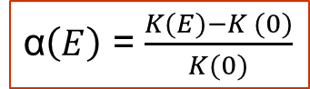
DMS Introduction
Ion source
Atmospheric pressure
Detector
t
t
α = 0
va
1
2
Continues
gas flow
-50
-40
-30
-20
-10
0
10
20
30
40
50
CoV (V)
α$\left(E\right)$ = $\frac{K(E)−K (0)}{K(0)}$
Modifiers
EtOH
MeOH
Toluene
Cyclohexane
vr
E_{high}
Differential Ion Mobility (DMS)
Field Asymmetric Ion Mobility (FAIMS)
SV
CoV
E_{low}
Waveform generator
DC power supply
ACS Spring 2025 | CINF & COMP | Machine Learning in Chemistry
4

Slide 5
DMS & Modifier Chemistry
E_{high}
K (E)
CoV (V)
100 % N₂
100
Hard-sphere interactions
E_{low}
K (0)
SV (V)
K (E) < K(0)
0
4000
t₁
t₂
-100
Clustering - declustering
K (E) > K(0)
Modifier – polar organic solvent
1.5 – 3 % in the N₂
t₁
t₂
Schneider B., Covey T. Anal. Chem. (2010)
ACS Spring 2025 | CINF & COMP | Machine Learning in Chemistry
5

Slide 6
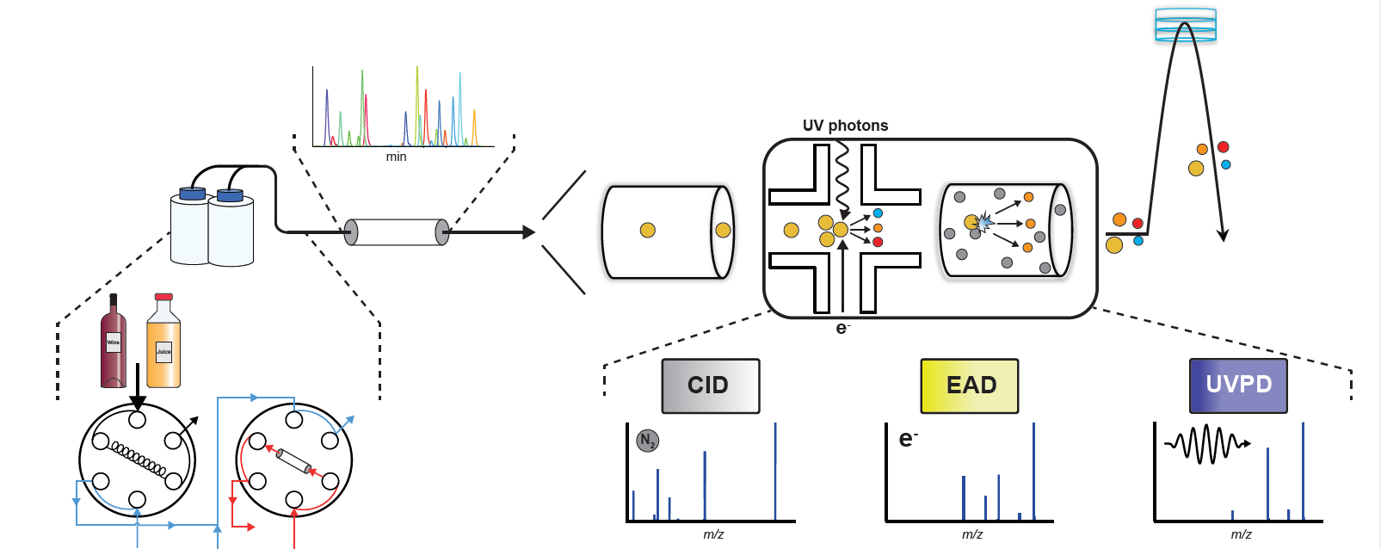
Fragmentation Techniques
(gas, electrons and photons)
ACS Spring 2025 | CINF & COMP | Machine Learning in Chemistry
6

Slide 7
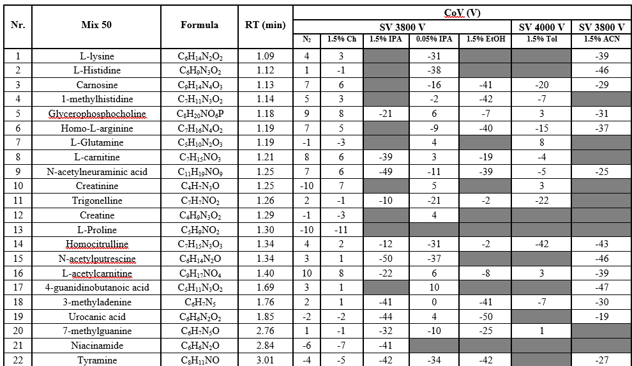
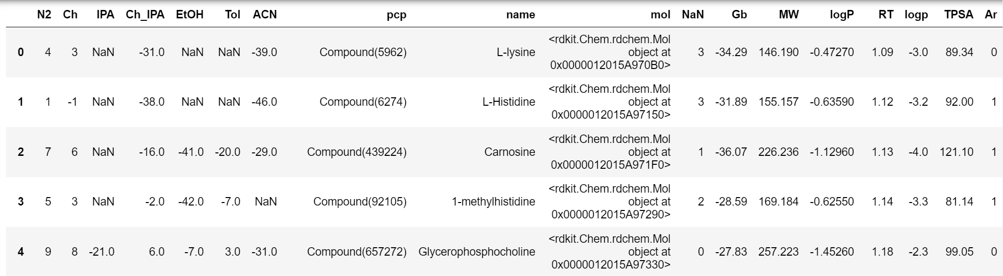
Data-Driven Insights into Differential Ion Mobility (DMS):
50 low molecular weight compounds
import pubchempy as pcp
pcp.get_compounds('L-lysine','name')[0]
ACS Spring 2025 | CINF & COMP | Machine Learning in Chemistry
7

Slide 8
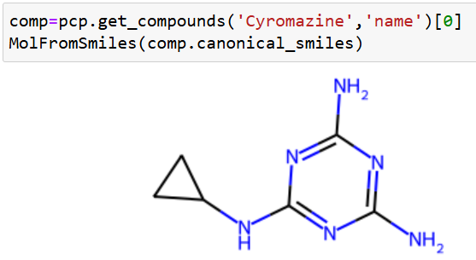
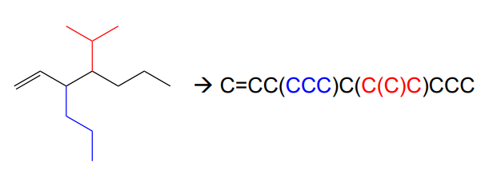
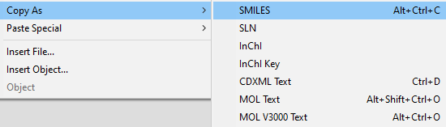
Where from mol?
How easiest to obtain SMILES?
Draw a structure in ChemDraw:

Slide 9
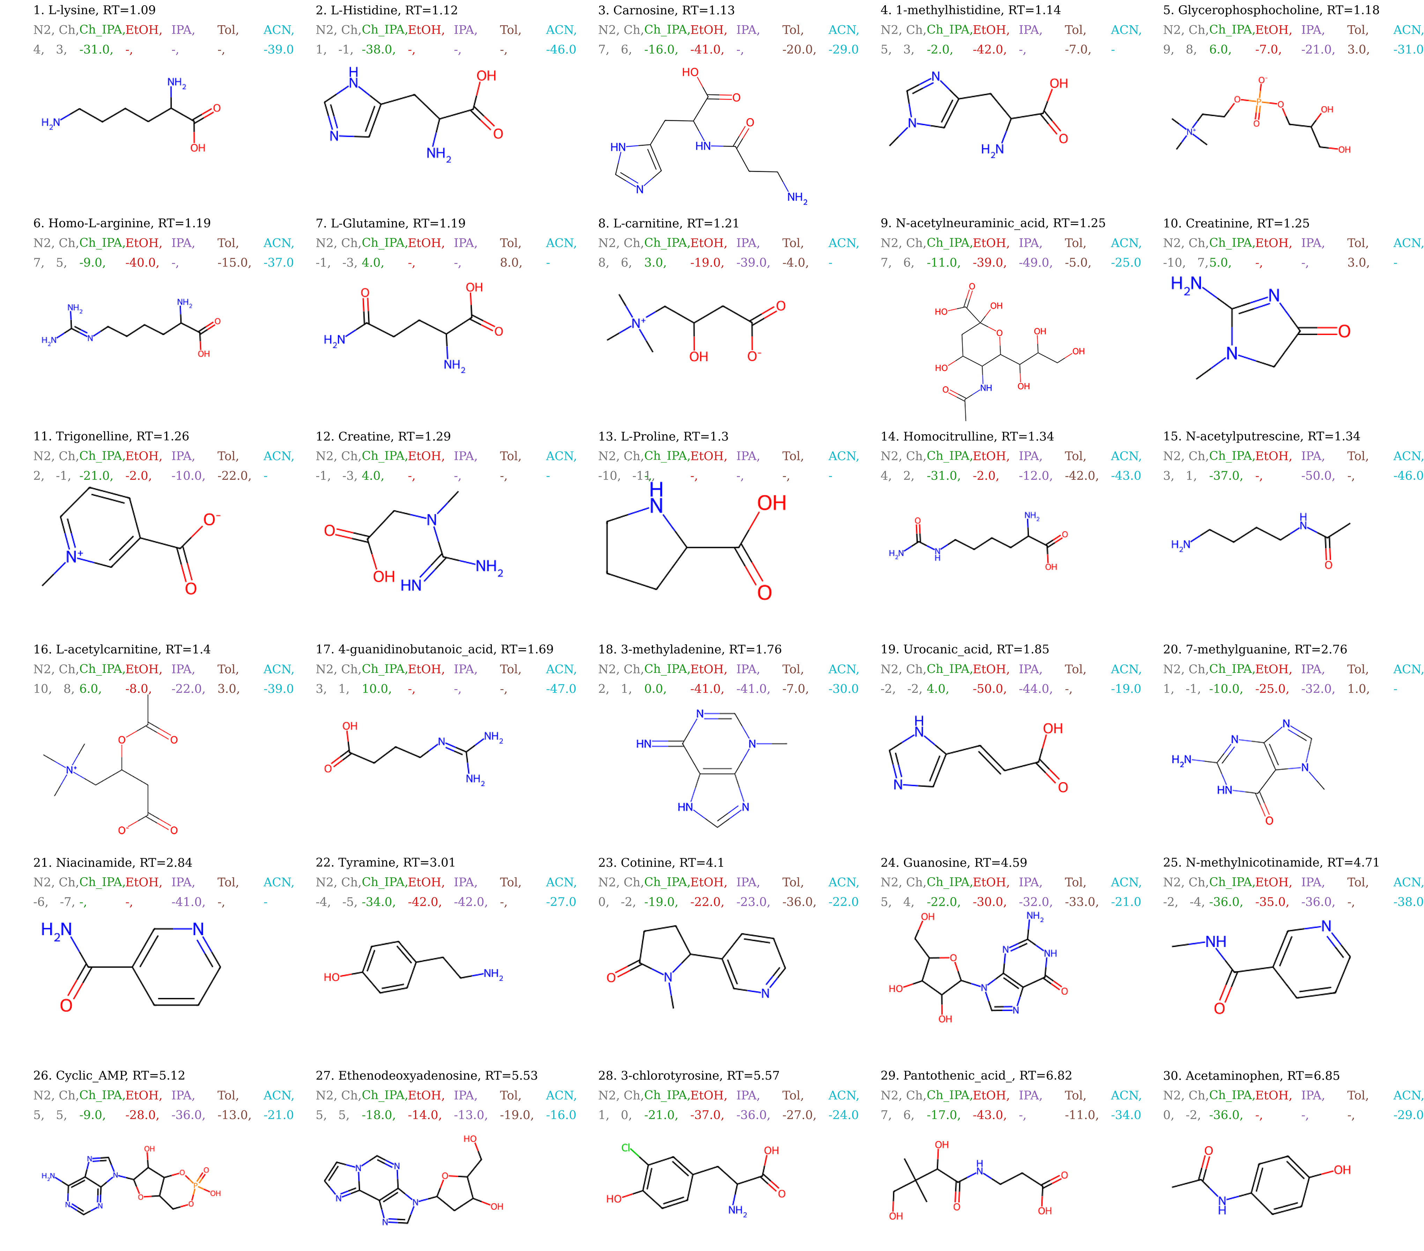
Data-Driven Insights into Differential Ion Mobility (DMS):

Slide 10
Data-Driven Insights into Differential Ion Mobility (DMS):

Slide 11
Data-Driven Insights into Differential Ion Mobility (DMS):
CoV (EtOH) and CoV(IPA) with R²=0.81
CoV between non-clustering modifier Cyclohexane and N₂ with R²=0.68
MW with CoV(N₂), CoV(cyclohexane), CoV(ACN), RT and TPSA
RT with logP, MW, CoV(ACN), proton affinity(Gb) and CoV(IPA)
$$RT = 1.72∙logP + 0.035∙MW + 0.198∙Gb + 3.95, { R}^{2} = 0.9$$
$$RT = 1.64∙logP + 0.042∙MW −0.004∙CoV\left(IPA\right) −4.1, R^{2} = 0.92$$
ACS Spring 2025 | CINF & COMP | Machine Learning in Chemistry
11

Slide 12
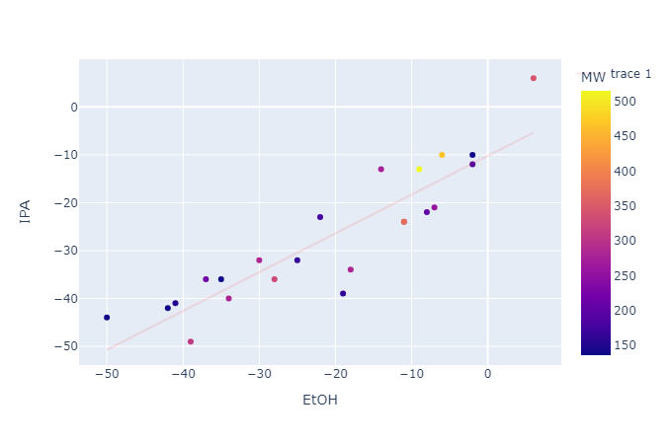
Data-Driven Insights into modifier assisted Differential Ion Mobility (DMS):

Slide 13
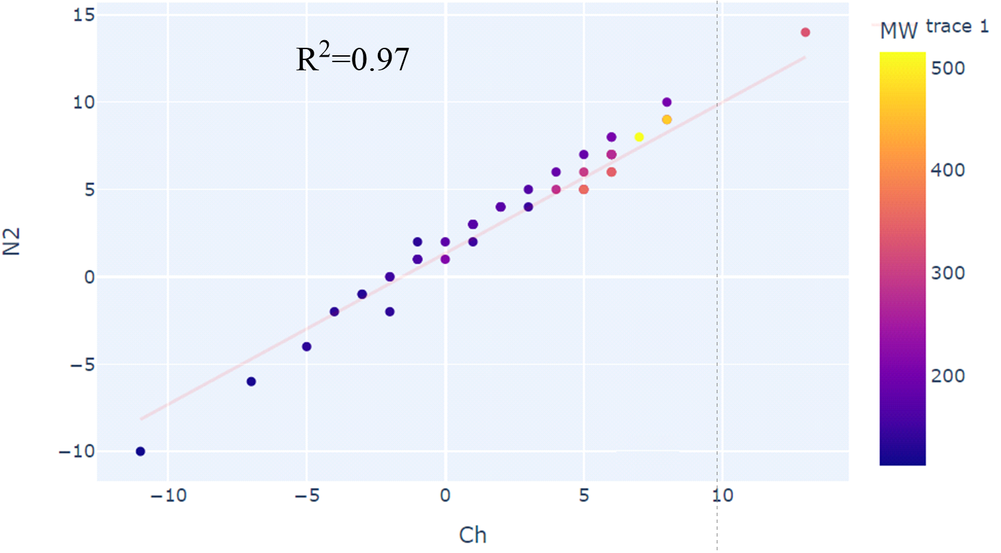
Data-Driven Insights into Differential Ion Mobility (mDMS):

Slide 14
Data-Driven Insights into Differential Ion Mobility (DMS):

Slide 15
Data-Driven Insights into Differential Ion Mobility (DMS):

Slide 16
Data-Driven Insights into Differential Ion Mobility (DMS):

Slide 17

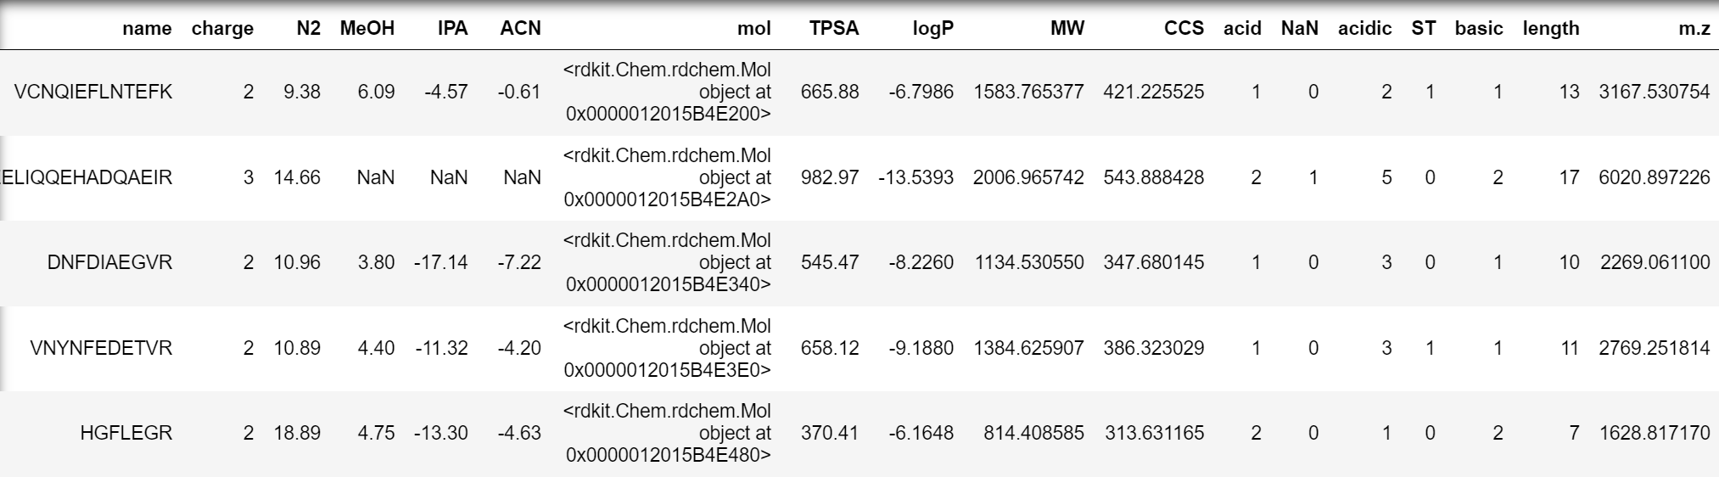
Signal Suppression for Peptides
185 peptides with 6-20 AAs
Peptide sequence | charge | N2 | MeOH | IPA | ACN | TPSA | logP | MW | css | acid | NaN | ST | basic | acidic | length
VCNQIEFLNTEFK | 2 | 9.4 | 6.1 | -4.6 | -0.6 | 666 | -7 | 1583.8 | 421 | 1 | 0 | 1 | 1 | 2 | 13
QAEELIQQEHADQAEIR | 3 | 14.7 |  |  |  | 983 | -14 | 2007.0 | 544 | 2 | 1 | 0 | 2 | 5 | 17
DNFDIAEGVR | 2 | 11.0 | 3.8 | -17.1 | -7.2 | 545 | -8 | 1134.5 | 348 | 1 | 0 | 0 | 1 | 3 | 10
VNYNFEDETVR | 2 | 10.9 | 4.4 | -11.3 | -4.2 | 658 | -9 | 1384.6 | 386 | 1 | 0 | 1 | 1 | 3 | 11
HGFLEGR | 2 | 18.9 | 4.8 | -13.3 | -4.6 | 370 | -6 | 814.4 | 314 | 2 | 0 | 0 | 2 | 1 | 7

Slide 18
Signal Suppression for Peptides
CSS, MW, charge, TPSA and peptide length
are all intercorrelated
MW is very nicely correlated with the CoV
for all polar modifiers
R²≈0 for CoV(N₂) vs MW/CCS/ peptide length
CoV(IPA) is correlated with both MeOH(R²=0.53)
and ACN (R²=0.76)
The absence of CoV values is nicely
correlated with charge (R²=0.41)

Slide 19
Signal Suppression for Peptides
CoV ranges: N₂(21.72V to 7.19V), MeOH (9.51V to -6.93V), IPA (-1.28V to -23.63V) and ACN (1.69V to -10.81V)
The features used are: peptide charge, CoV(N₂), TPSA, MW, number of basic AAs(base), number of Ser + Thr residuer (ST), number of acidic sidechains (acid), and length of peptide.
Scaled and 5-fold cross validation
Grid hyperparameter search for Support Vector, Decision Tree, Random Forest, XGBoost, K-Nearest Neighbors (KNN), Logistic Regression and Ridge classifiers is performed and compaired with “Logistic Regression CV”
Accuracy of 0.89, precision of 0.93, recall of 0.81, F1 score of 0.87, and an AUC-ROC of 0.90.
Feature importance: coefficient analysis, permutation feature importance, SHAP Values (peptide charge and three strongly related features describing peptide size: MW, TPSA and peptide length) and recursive feature elimination (RFE) - basic amino acids count.

Slide 20
Signal Suppression for Peptides

Slide 21
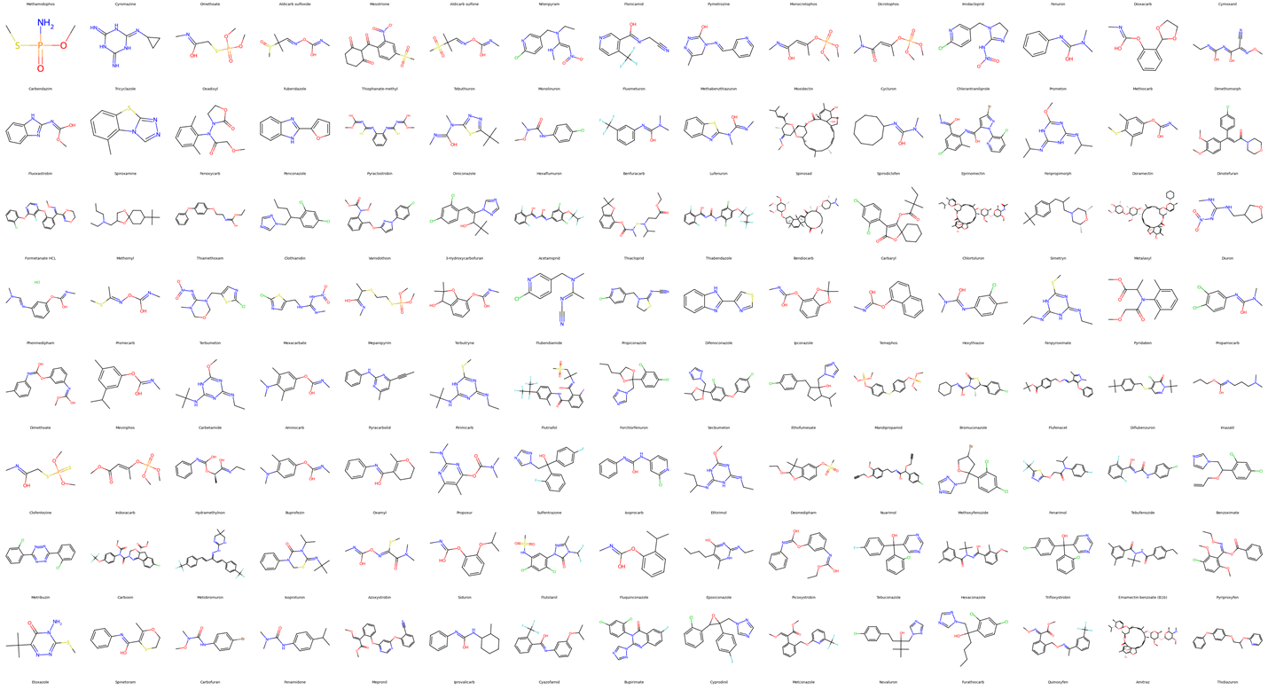
Machine Learning in Fragmentation

Slide 22
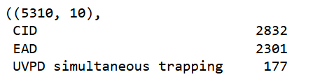
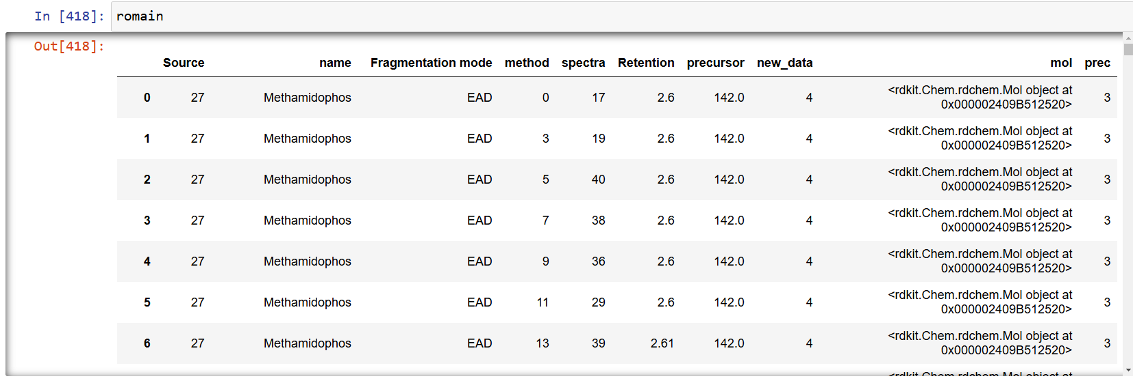

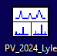
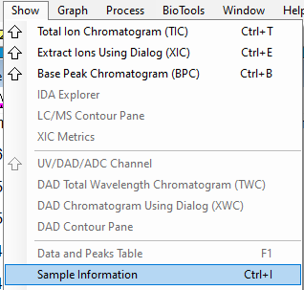
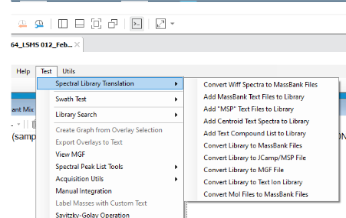
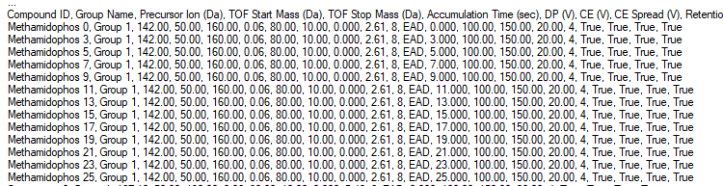
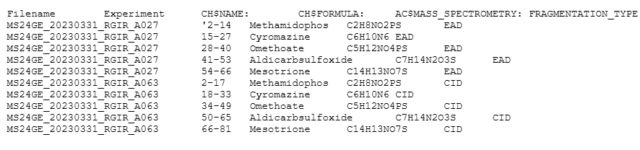
Machine Learning in Fragmentation
.wiff or .wiff2 → mzML
22
UniGE, Life Sciences Mass Spectrometry

Slide 23
Machine Learning in Fragmentation
When compared UVPD spectra and CID=15eV spectra, unique UVPD peaks are detected in 101 analytes while all peaks are also appearing in CID for 76 compounds
$$z=−0.32–1.16· +1.36· –0.74· +0.99· –0.61· +1.13·$$
Accuracy, Recall, Precision, F1 Score, ROC AUC ~ 0.71-0.75
When compared EAD vs combined CID spectra, we obtain redox active groups like Ar-Cl, OH, C=O…

Slide 24
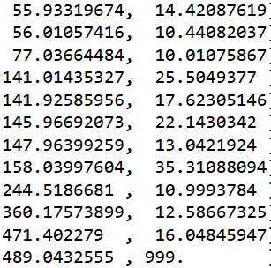
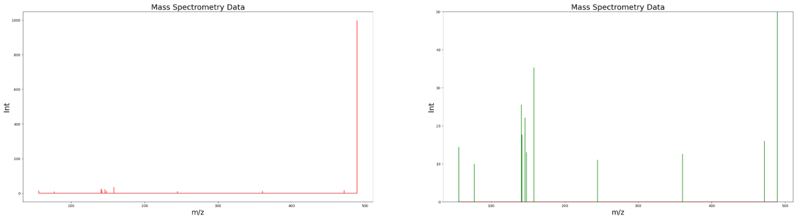
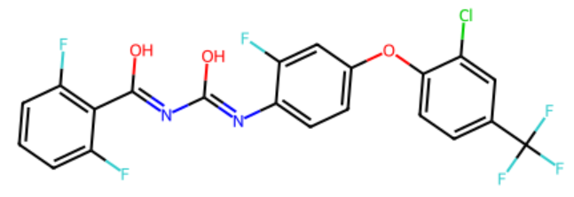
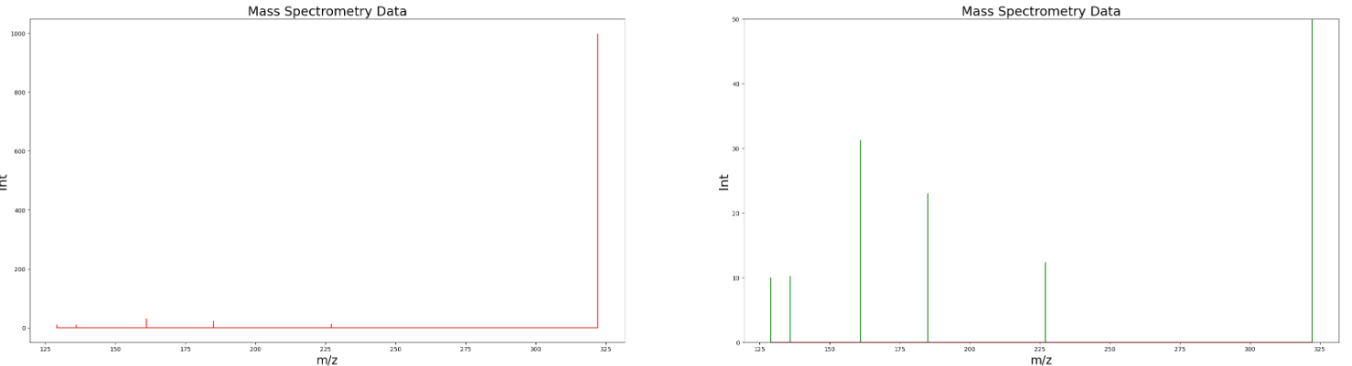
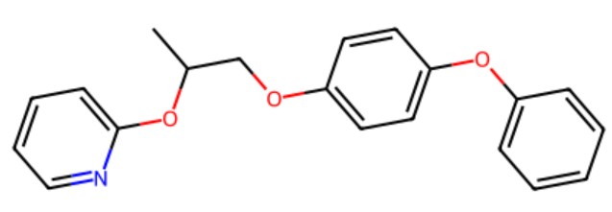
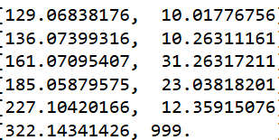
Machine Learning in Fragmentation
Flufenoxuron
[MH]⁺
[MH]^{·2+}
Pyriproxyfen
[MH]^{·2+}
[MH]⁺

Slide 25
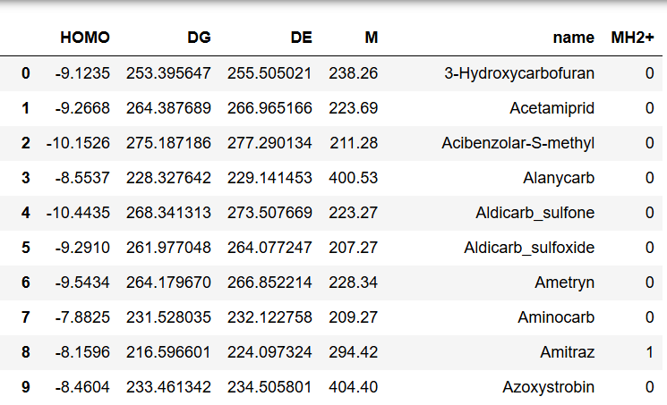
Machine Learning in Fragmentation
1) We need to obtain [MH]+ (protonate) all 170+ molecules
2) Optimize [MH]+ with some high level of theory,
we can then extract HOMO.
3) Freq on [MH]+ and opt/freq on [MH]·2+ in order to
get Gibbs free energy estimates
Model | Train Accuracy | Train Recall | Train Precision | Train F1 Score | Train ROC AUC | Test Accuracy | Test Recall | Test Precision | Test F1 Score | Test ROC AUC
Random Features | 0.62 | 0.62 | 0.68 | 0.59 | 0.58 | 0.52 | 0.52 | 0.53 | 0.48 | 0.42
ΔG Feature | 0.93 | 0.93 | 0.93 | 0.93 | 0.95 | 0.92 | 0.78 | 0.84 | 0.81 | 0.81
HOMO Feature | 0.69 | 0.69 | 0.69 | 0.69 | 0.79 | 0.72 | 0.67 | 0.6 | 0.6 | 0.85

Slide 26
Conclusions
Data science reveals key correlations between modifiers and molecular properties in DMS, identifying two major signal suppression mechanisms for small molecules.
Machine learning links peptide properties to proton transfer-induced MS signal suppression, enhancing our understanding of DMS behavior and improving peptide analysis.
Overlapping between CID, EAD, and UVPD fragmentation techniques for small molecule pesticides is clearly related to the FGs.
There is a significant correlations between the chemistry of small molecules and their molecular MS/MS behavior:
unique UVPD peaks ~ absorption chromophores
unique EAD peaks ~ redox FGs
observation of [MH]·2+ in EAD spectra ~ EAD energy and [MH]·2+ instability

Slide 27
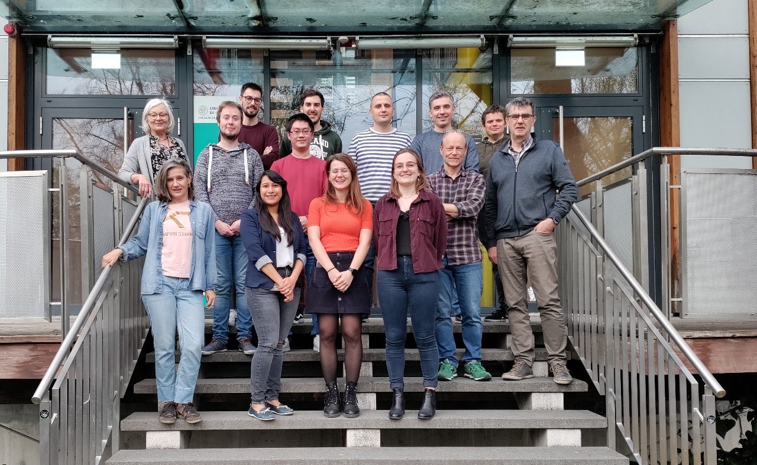


Acknowledgments
David Ruskic
Eliane Kuehn
Charlotte Jacquet
Piotr Sosnowski
Lysi Ekmekciu
Patrick Mueller
Maria Girard
Xiaobo Tian
Quentin Rouchon
Gisela Gonzalez
Bandar Alghanem
Romain Giraud
Ron Bonner

Slide 28
Enhanced Pesticide Screening in Wines and Juices by Column-Switching Liquid Chromatography-Tandem Mass Spectrometry Using Multiple Activation Methods
, Authors: Romain Giraud, J.C. Yves Le Blanc, Mircea Guna, Gérard Hopfgartner
Version 1 posted 20 January 2025
Extract found to contain search terms
Yves Le Blanc2, Mircea Guna2, Gérard Hopfgartner1* 1Life Sciences Mass Spectrometry, Department of Inorganic and Analytical Chemistry, University of Geneva, 24 Quai Ernest Ansermet, CH-1205, Geneva 4, Switzerland 2SCIEX, Toronto, Ontario, Canada LC-MS/MS, column switching, pesticides, juice, wine, general screening, CID-EAD-UVPD ORCID: Romain Giraud: 0009-0006-8180-2874 ORCID: Gérard Hopfgartner : 0000-0002-9087-606X *Corresponding author: Gérard Hopfgartner

